Slide 1

MOBILE DEVELOPMENT
COMPUTER SCIENCE
Topic 9:
Introduction to API
version 1.0
Copyright © 2020 by Singapore Institute of Management Pte Ltd. All rights reserved.

Slide 2

Learning Outcomes
After studying this topic and the recordings online, you should be able to:
Topic 9 – Introduction to API
What is an API?
How do APIs work?
APIs Jargon
Push Notification

Slide 3

What is an API?
API stands for application programming interface.
It is a set of definitions and protocols for building and integrating application software.
Notes:
B

Slide 4
How do APIs work?
APIs let your product or service communicate with other products and services without having to know how they’re implemented.
This can simplify app development, saving time and money.
Notes:
B

Slide 5
How do APIs work?
When you’re designing new tools and products or managing existing ones. APIs give you:
Flexibility
Simplify design
Administration, and use
Provide opportunities for innovation.
Notes:
B

Slide 6
How do APIs work?
For example, imagine a book-distributing company.
The book distributor could give its customers a cloud app that lets bookstore clerks check book availability with the distributor.
This app could be expensive to develop, limited by platform, and require long development times and ongoing maintenance.
Notes:
B

Slide 7
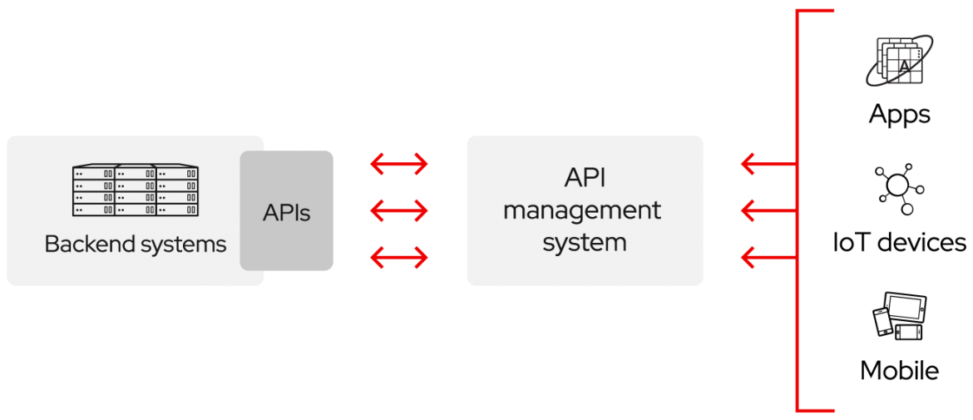
How do APIs work?
Alternatively, the book distributor could provide an API to check stock availability.
Notes:
B

Slide 8
How do APIs work?
There are several benefits to this approach:
Letting customers access data via an API helps them aggregate information about their inventory in a single place.
The book distributor can make changes to its internal systems without impacting customers, so long as the behavior of the API doesn’t change.
Notes:
B

Slide 9
How do APIs work?
There are several benefits to this approach:
With a publicly available API, developers working for the book distributor, book sellers or third parties could develop an app to help customers find the books they’re looking for.
This could result in higher sales or other business opportunities.
Notes:
B

Slide 10
API Jargons
There are a few API Jargons that we need to take note:
REST
RPC
SOAP
Notes:
B

Slide 11
API Jargons
REST
REST is a set of architectural constraints, not a protocol or a standard. API developers can implement REST in a variety of ways.
When a client request is made via a RESTful API, it transfers a representation of the state of the resource to the requester or endpoint.
Notes:
B

Slide 12
API Jargons
REST
This information, or representation, is delivered in one of several formats via HTTP:
JSON (Javascript Object Notation), HTML, XLT, Python, PHP, or plain text.
JSON is the most generally popular file format to use because, despite its name, it’s language-agnostic, as well as readable by both humans and machines.
Notes:
B

Slide 13
API Jargons
RPC
RPC is the earliest, simplest form of API interaction. It is about executing a block of code on another server, and when implemented in HTTP or AMQP it can become a Web API.
There is a method and some arguments, and that is pretty much it.
Think of it like calling a function in JavaScript, taking a method name and arguments.
Notes:
B

Slide 14
API Jargons
RPC
In JavaScript, we would do the same by defining a function, and later we’d call it elsewhere:
/* Signature */ function rpcAPIFunc(value) { // ... } /* Usage */ rpcAPIFunc(“Hello World");
Notes:
B

Slide 15
API Jargons
RPC
The idea is the same. An API is built by defining public methods, then, the methods are called with arguments.
RPC is just a bunch of functions, but in the context of an HTTP API, that entails putting the method in the URL and the arguments in the query string or body.
Notes:
B

Slide 16
API Jargons
SOAP
SOAP or Simple Objects Access Protocol is a web communication protocol designed for Microsoft back in 1998.
SOAP, unlike the REST pattern, supports the XML data format only and strongly follows preset standards such as messaging structure, a set of encoding rules, and a convention for providing procedure requests and responses.
Notes:
B

Slide 17
API Jargons
SOAP
While most web data exchange happens over REST exchange.
SOAP isn’t disappearing anytime soon, because it’s highly standardized, allows for automation in certain cases, and it’s more secure.
Notes:
B

Slide 18
Demonstrating with APIs
Now that we understood the terminology of API jargon.
Let’s try out an application that calls a REST API for data.
Notes:
B

Slide 19
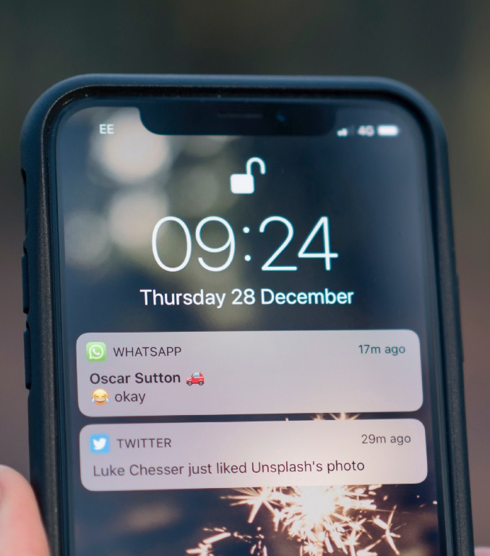
Push Notifications
A push notification is a message that pops up on a mobile device.
App publishers can send them at any time.
Users don’t have to be in the app or using their devices to receive them.
Notes:
B

Slide 20
Push Notifications
They can do a lot of things:
They can show the latest sports scores
Get a user to take an action, such as downloading a coupon.
Let a user know about an event, such as a flash sale.
Notes:
B

Slide 21
Push Notifications
Push notifications look like SMS text messages and mobile alerts, but they only reach users who have installed your app.
Each mobile platform has support for push notifications.
iOS, Android, Fire OS, Windows and BlackBerry all have their own services.
Notes:
B

Slide 22
Push Notifications
Here are the rules for creating perfect push notifications.
Avoid sending too many notifications in a short period of time.
Create a short title if it provides context for the notification content.
Don’t include sensitive/confidential information.
Write easy to read notification content.
Notes:
B

Slide 23
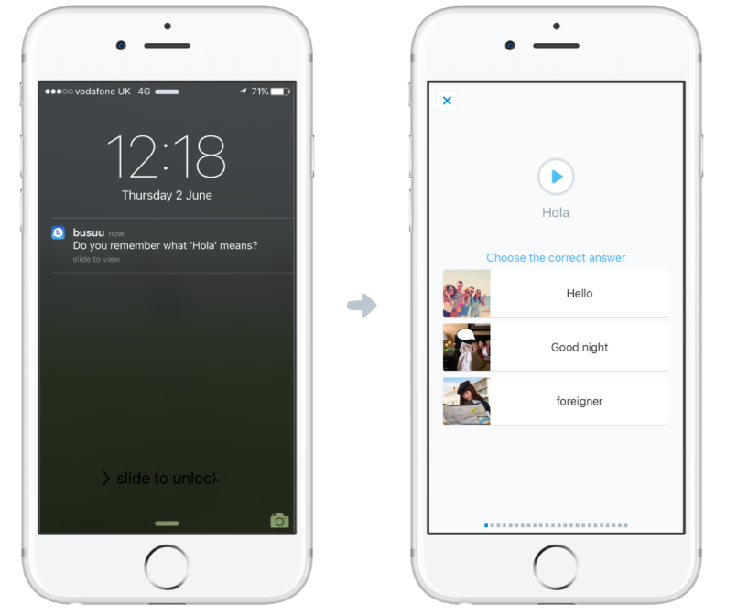
Push Notifications
Here are the rules for creating perfect push notifications.
Link to a
valuable
action.
Notes:
B

Slide 24
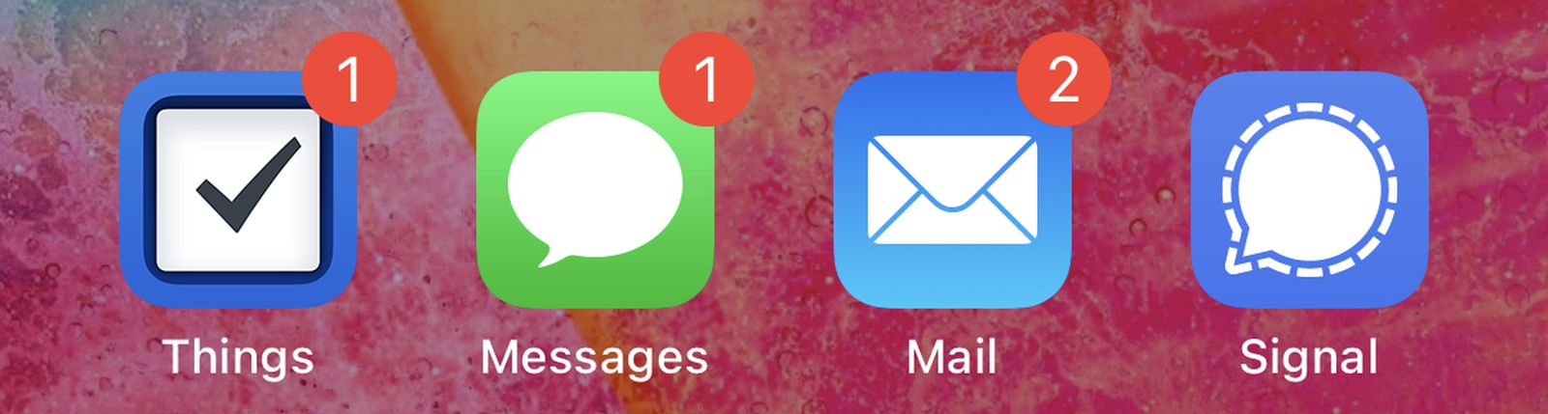
Push Notifications
What are badges?
Badges are a number to indicate something, such as how many missed messages a user has.
Notes:
B

Slide 25
Push Notifications
Let’s give it a go with a push notification application.
Before we start, push notification are sent via API. Thus, we will be using the push notification tool provided by expo.
https://expo.dev/notifications
Notes:
B

Slide 26
That’s all for today!
If you have any questions, please feel free to reach out to me at this email.
kydsim001@mymail.sim.edu.sg
Notes:
B

Slide 27
END OF LESSON

